Slide 1
Computer Networks CS 3001 (BCS-5B) Lecture 3
Danyal Farhat
FAST School of Computing
NUCES Lahore

Slide 2
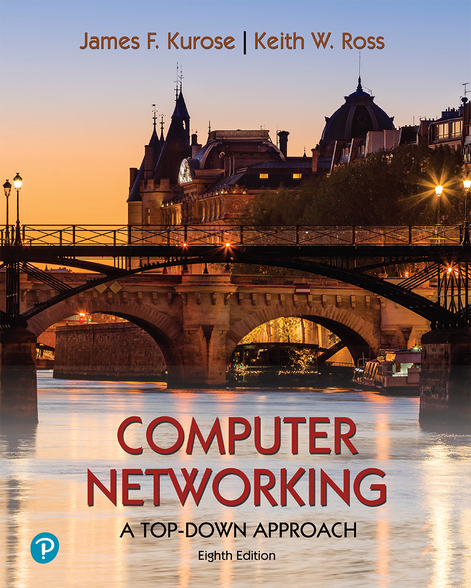
Chapter 3 Transport Layer
A note on the use of these PowerPoint slides:
We’re making these slides freely available to all (faculty, students, readers). They’re in PowerPoint form so you see the animations; and can add, modify, and delete slides (including this one) and slide content to suit your needs. They obviously represent a lot of work on our part. In return for use, we only ask the following:
If you use these slides (e.g., in a class) that you mention their source (after all, we’d like people to use our book!)
If you post any slides on a www site, that you note that they are adapted from (or perhaps identical to) our slides, and note our copyright of this material.
For a revision history, see the slide note for this page.
Thanks and enjoy! JFK/KWR
All material copyright 1996-2023
J.F Kurose and K.W. Ross, All Rights Reserved
Computer Networking: A Top-Down Approach 8th edition Jim Kurose, Keith Ross Pearson, 2020
Notes:
Version History
8.0 (April 2020)
All slides reformatted for 16:9 aspect ratio
All slides updated to 8th edition material
Use of Calibri font, rather that Gill Sans MT
Add LOTS more animation throughout
added new 8th edition material on QUIC, CUBIC, delay-based congestion control
lighter header font
8.2 (July 2023): changes from 8.0
minor updates throughout, but not much changes from 8.0

Slide 3
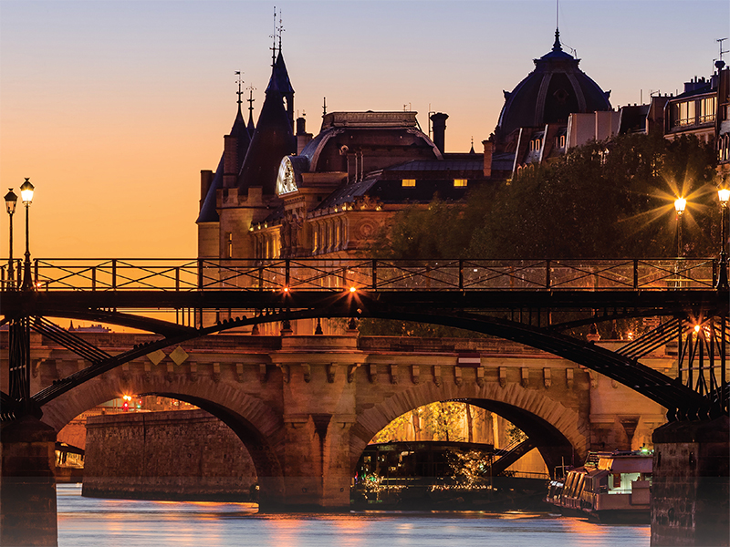
Chapter 3: roadmap
Transport-layer services
Multiplexing and demultiplexing
Connectionless transport: UDP
Principles of reliable data transfer
Connection-oriented transport: TCP
Principles of congestion control
TCP congestion control

Slide 4
UDP: User Datagram Protocol
Why is there a UDP?
“no frills,” “bare bones” Internet transport protocol
“best effort” service, UDP segments may be:
lost
delivered out-of-order to app
no connection establishment (which can add RTT delay)
simple: no connection state at sender, receiver
small header size
no congestion control
UDP can blast away as fast as desired!
can function in the face of congestion
connectionless:
no handshaking between UDP sender, receiver
each UDP segment handled independently of others

Slide 5
UDP: User Datagram Protocol
UDP use:
streaming multimedia apps (loss tolerant, rate sensitive)
DNS
SNMP
HTTP/3
if reliable transfer needed over UDP (e.g., HTTP/3):
add needed reliability at application layer
add congestion control at application layer

Slide 6
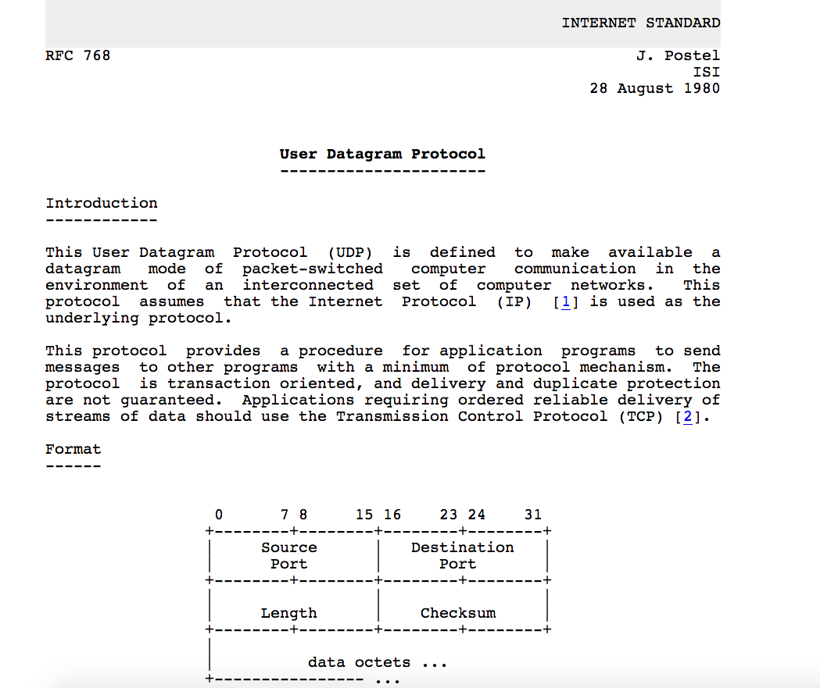
UDP: User Datagram Protocol [RFC 768]
Notes:
read this RFC – it’s only 2.5 pages!

Slide 7
UDP: Transport Layer Actions
SNMP client
SNMP server
application
application
transport
(UDP)
transport
(UDP)
network (IP)
network (IP)
link
link
physical
physical

Slide 8
UDP: Transport Layer Actions
SNMP client
SNMP server
UDP sender actions:
application
application
is passed an application-layer message
SNMP msg
transport
(UDP)
transport
(UDP)
determines UDP segment header fields values
UDP_{h}
SNMP msg
UDP_{h}
creates UDP segment
network (IP)
network (IP)
passes segment to IP
link
link
physical
physical

Slide 9
UDP: Transport Layer Actions
SNMP client
SNMP server
UDP receiver actions:
application
receives segment from IP
application
checks UDP checksum header value
transport
(UDP)
transport
(UDP)
SNMP msg
extracts application-layer message
network (IP)
network (IP)
SNMP msg
UDP_{h}
demultiplexes message up to application via socket
link
link
physical
physical

Slide 10
UDP segment header
32 bits
source port #
dest port #
length
checksum
application
data
(payload)
length, in bytes of UDP segment, including header
data to/from application layer
UDP segment format

Slide 11

UDP checksum
Goal: detect errors (i.e., flipped bits) in transmitted segment
1st number
2nd number
sum
Transmitted: 5 6 11
Received: 4 6 11
receiver-computed
checksum
=
sender-computed
checksum (as received)

Slide 12
Internet checksum
Goal: detect errors (i.e., flipped bits) in transmitted segment
sender:
treat contents of UDP segment (including UDP header fields and IP addresses) as sequence of 16-bit integers
checksum: addition (one’s complement sum) of segment content
checksum value put into UDP checksum field
receiver:
compute checksum of received segment
check if computed checksum equals checksum field value:
not equal - error detected
equal - no error detected. But maybe errors nonetheless? More later ….

Slide 13
Internet checksum: an example
example: add two 16-bit integers
1 1 1 0 0 1 1 0 0 1 1 0 0 1 1 0
1 1 0 1 0 1 0 1 0 1 0 1 0 1 0 1
wraparound
1 1 0 1 1 1 0 1 1 1 0 1 1 1 0 1 1
sum
1 0 1 1 1 0 1 1 1 0 1 1 1 1 0 0
checksum
0 1 0 0 0 1 0 0 0 1 0 0 0 0 1 1
Note: when adding numbers, a carryout from the most significant bit needs to be added to the result
* Check out the online interactive exercises for more examples: http://gaia.cs.umass.edu/kurose_ross/interactive/

Slide 14
Internet checksum: weak protection!
example: add two 16-bit integers
0 1
1 1 1 0 0 1 1 0 0 1 1 0 0 1 1 0
1 0
1 1 0 1 0 1 0 1 0 1 0 1 0 1 0 1
wraparound
1 1 0 1 1 1 0 1 1 1 0 1 1 1 0 1 1
Even though numbers have changed (bit flips), no change in checksum!
sum
1 0 1 1 1 0 1 1 1 0 1 1 1 1 0 0
checksum
0 1 0 0 0 1 0 0 0 1 0 0 0 0 1 1

Slide 15
Summary: UDP
“no frills” protocol:
segments may be lost, delivered out of order
best effort service: “send and hope for the best”
UDP has its plusses:
no setup/handshaking needed (no RTT incurred)
can function when network service is compromised
helps with reliability (checksum)
build additional functionality on top of UDP in application layer (e.g., HTTP/3)

Slide 16
Thank You!

